Slide 1
SOC Use Cases
Sonika Verma
CSCD92: Week 12

Slide 2
SOC & SIEM Use Case Templates
Standard Operating Procedures
Use Case
Business functions
Design questions to be answered
Test data and sources
Evaluate data by baselines
SIEM content
SOC guidelines
testing

Slide 3
SOC & SIEM Partial Use Cases
Windows Network User Preference
Employee investigation
Desktop presence, monitoring, and logging
System Logging
System reporting and activity baselines
External & Internal Access
VPN, desktops, servers…
IDS Stacked Events
Triggered events and alarms
Policy Violation Issues
Intrusion Detection System configurations

Slide 4
SOC & SIEM Use Case Templates
Building Templates & Playbooks
Name
Purpose
Problem Statement
Requirements
Design Specifications
SOC Notification
Component Names
Data Source Description
Data Stream Analysis & Field Set
Cyber Kill Chain Analysis & Support
Assumptions & Limitations
Alternate Solution & Discussion
Deliverable Profile

Slide 5
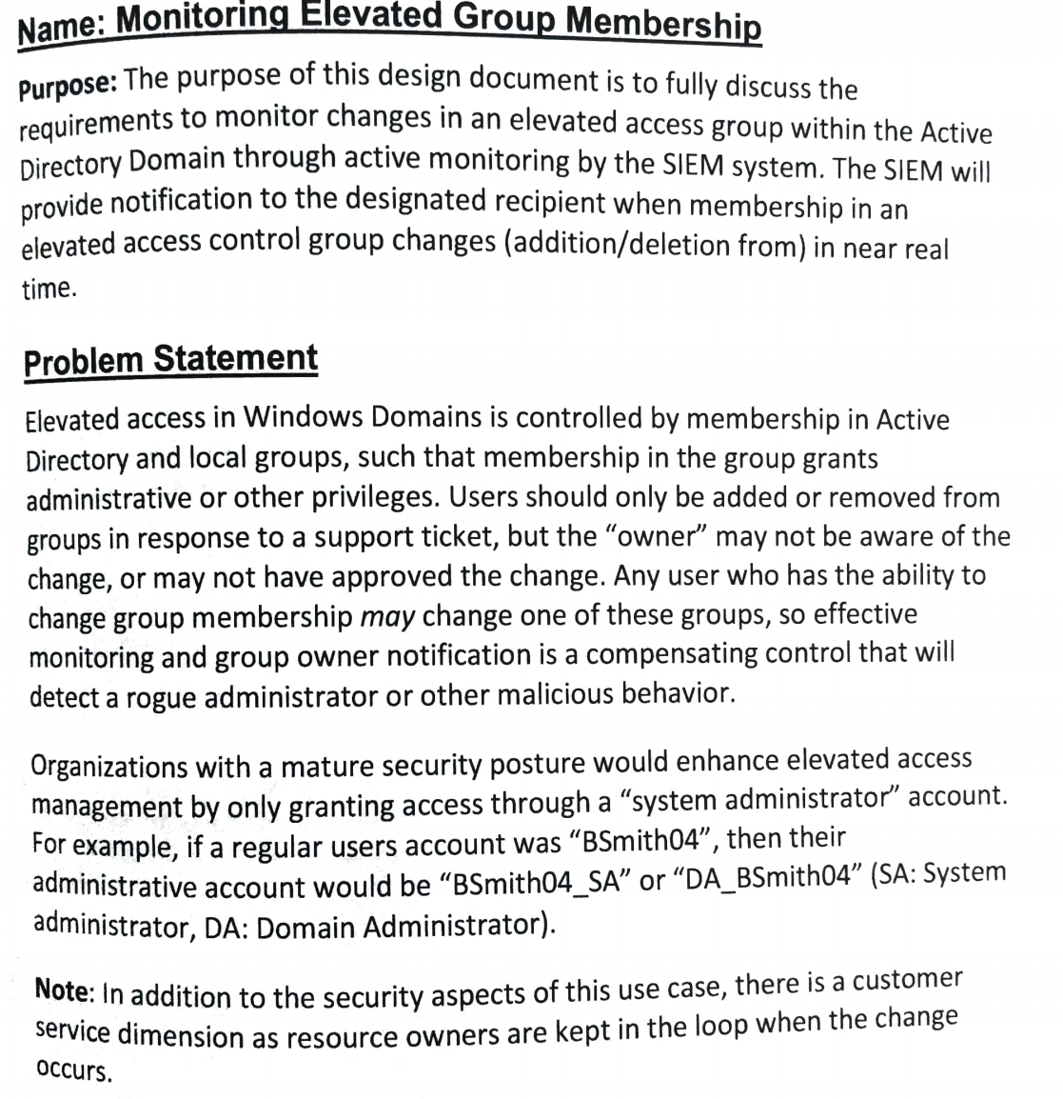
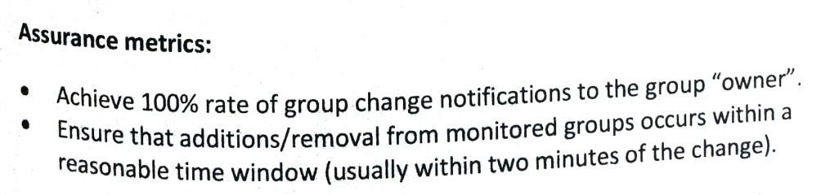
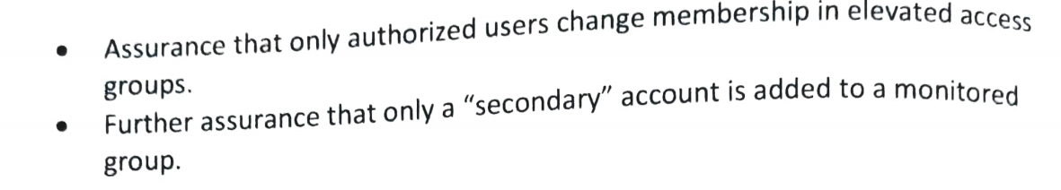

Slide 6
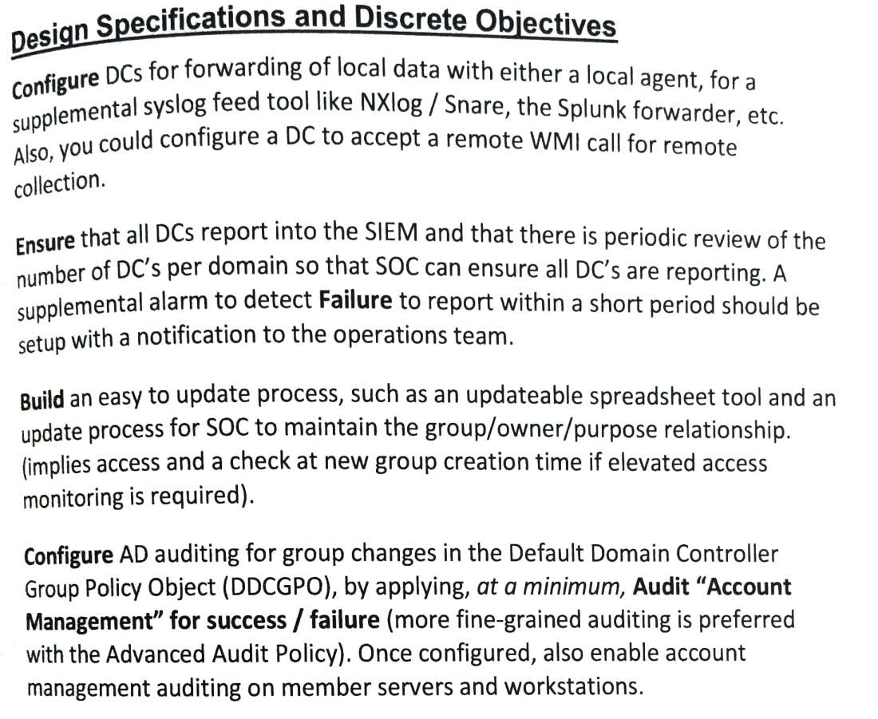
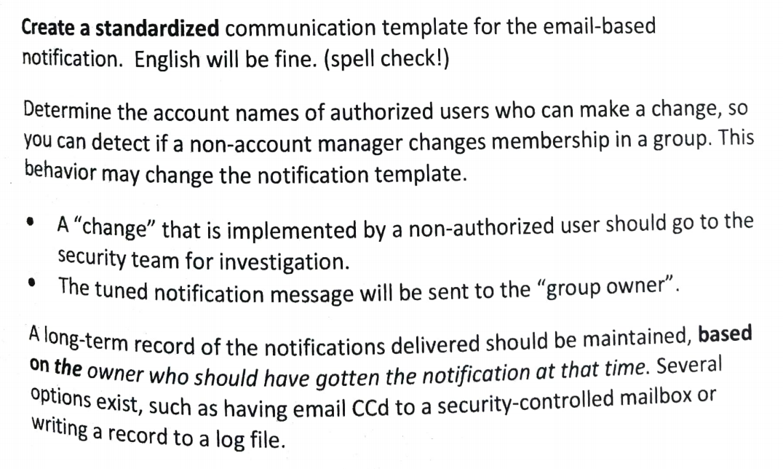

Slide 7
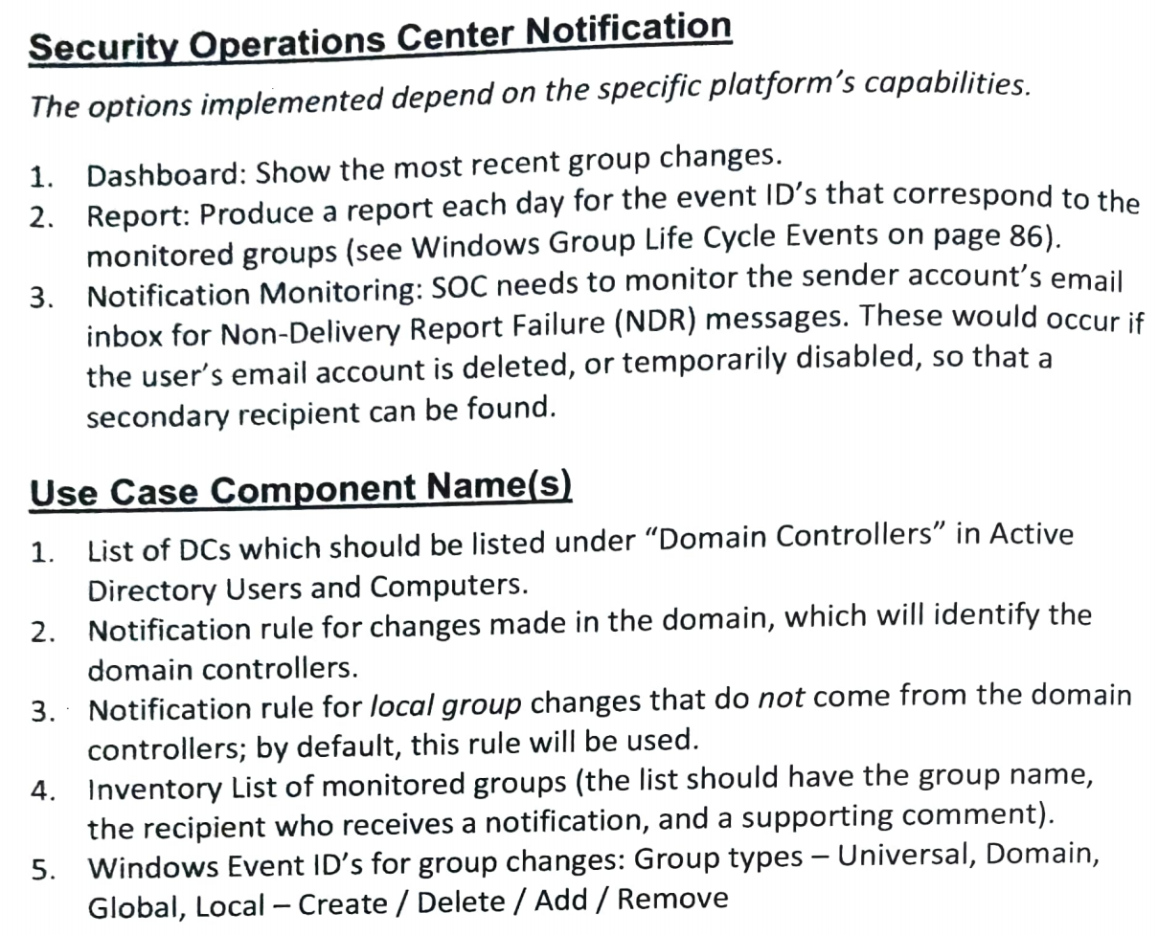
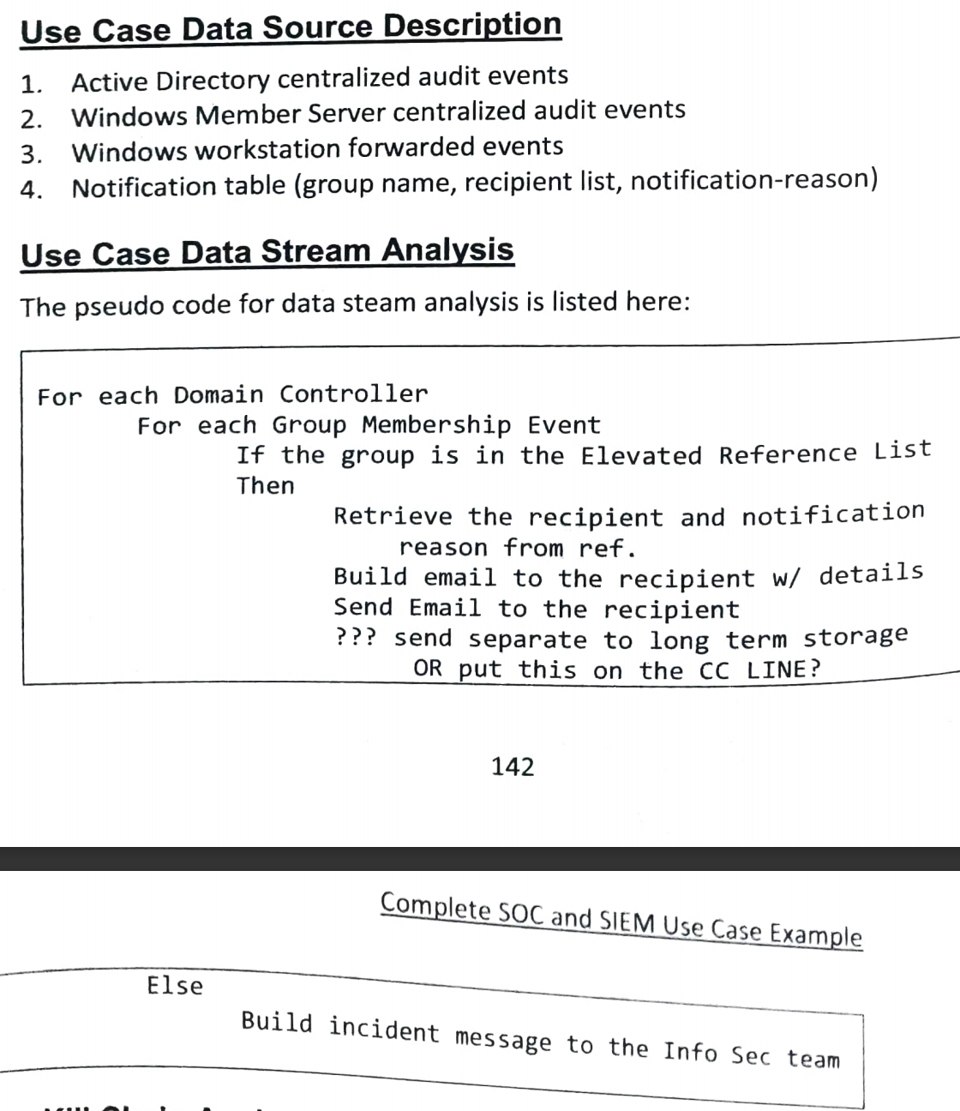

Slide 8
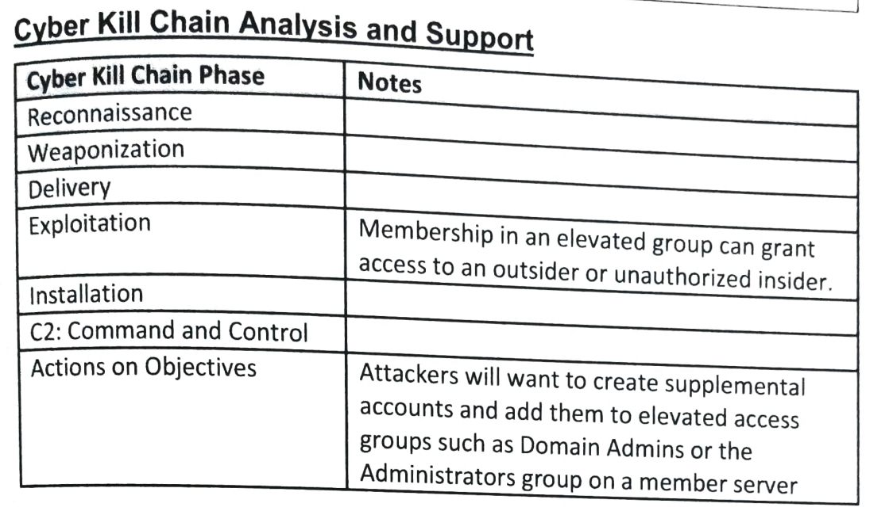
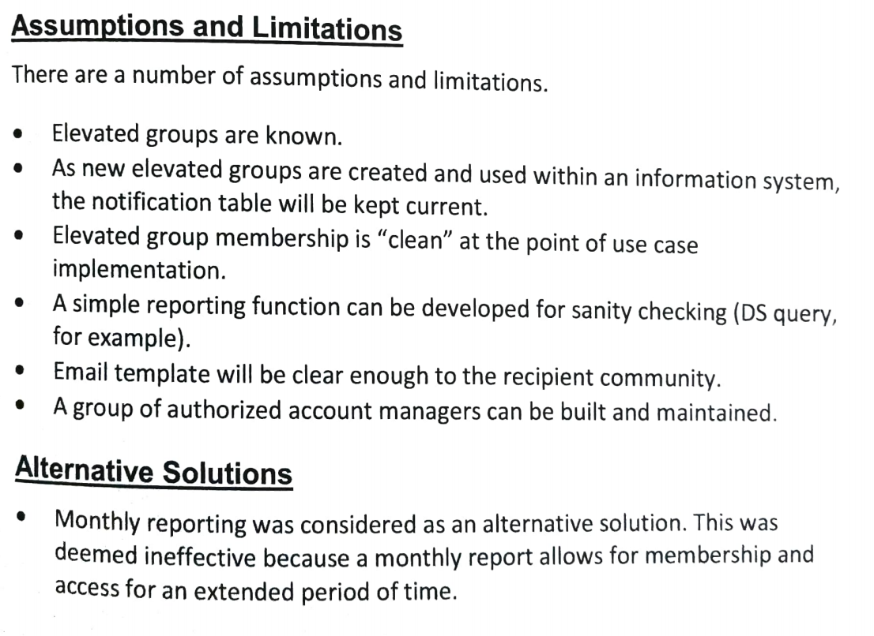

Slide 9
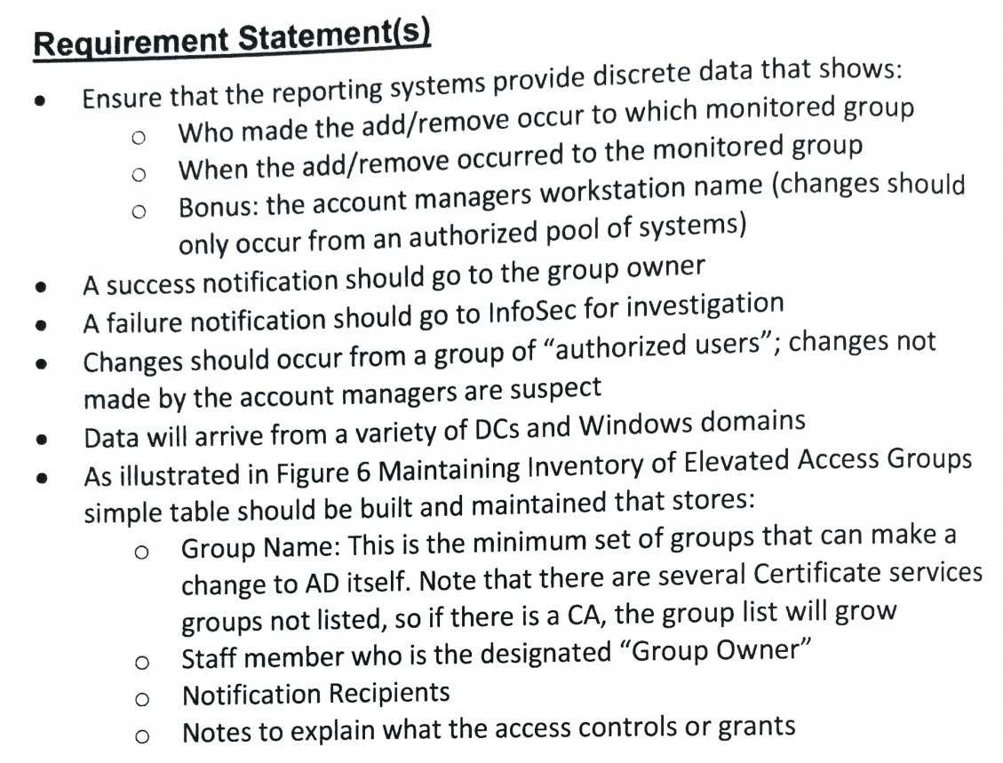
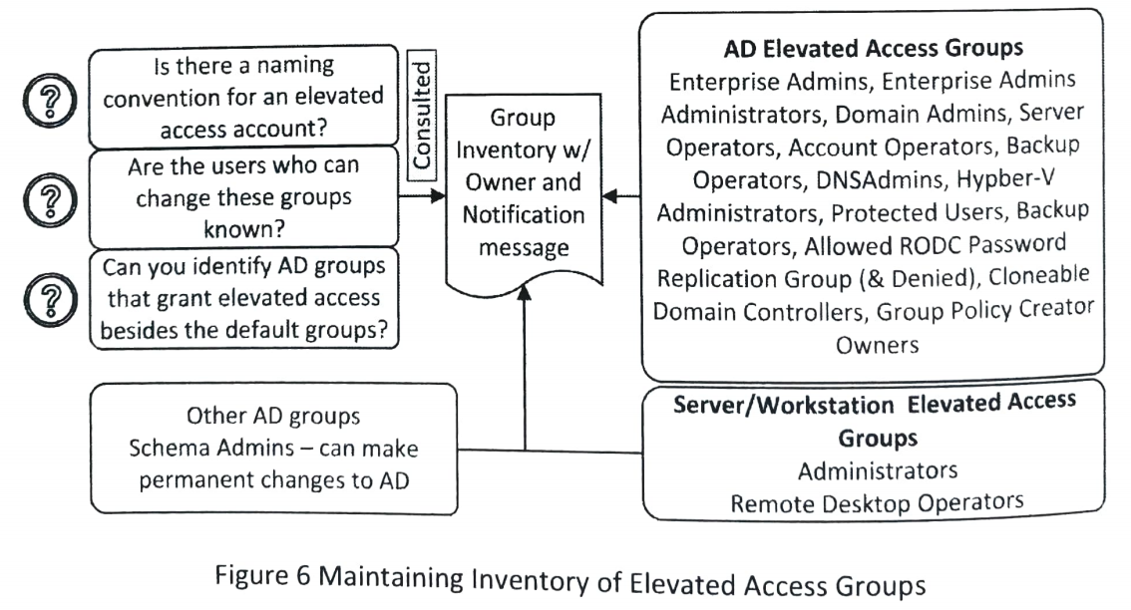

Slide 10
SOC Threat Hunting
Sonika Verma
CSCD92: Week 12

Slide 11
Threat Hunting Practices
Threat hunting
SANS guidance
Generating hypothesis, threat hunter abilities
Benefits of threat hunting
Maximize security, detect deviations, detect adversaries, determine baselines
Common practices
Normal activity
Firewall denies
System stability
Outbound threat intel contacts
Device communication
Web proxy block traffic

Slide 12
Threat Hunting Checklist
Prepare and execute threat hunting
Observe potential adversaries
Leverage strong egress action
Privileged accounts
Account lifecycles
Registered domains
Security research
Known and discovered vulnerabilities and attacks
Pen testing
Cyber kill chain

